Slide 1
Classical Encryption Techniques
Introduction to Network Security

Slide 2
Classical encryption techniques
Encryption :-
Encryption is something like making a secret letter by changing, swapping or replacing characters in previously defend order. The format of the message is not changed.
Encoding :-
In coding the format of data is changed. For example we record a voice sample, the recorder will encode the analog voice signals into digital signals & store.

Slide 3
Basic terminology
Plaintext: original message to be encrypted
Ciphertext: the encrypted message
Enciphering or encryption: the process of converting plaintext into ciphertext
Encryption algorithm: performs encryption
Two inputs: a plaintext and a secret key

Slide 4
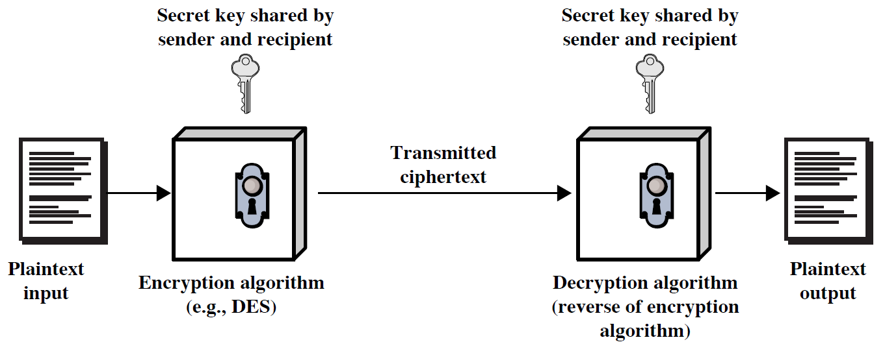
Symmetric Cipher Model

Slide 5
Deciphering or decryption: recovering plaintext from ciphertext
Decryption algorithm: performs decryption
Two inputs: ciphertext and secret key
Secret key: same key used for encryption and decryption
Also referred to as a symmetric key

Slide 6
Cipher or cryptographic system : a scheme for encryption and decryption
Cryptography: science of studying ciphers
Cryptanalysis: science of studying attacks against cryptographic systems
Cryptology: cryptography + cryptanalysis

Slide 7
Ciphers
Symmetric cipher: same key used for encryption and decryption
Block cipher: encrypts a block of plaintext at a time (typically 64 or 128 bits)
Stream cipher: encrypts data one bit or one byte at a time
Asymmetric cipher: different keys used for encryption and decryption

Slide 8
Symmetric Encryption
or conventional / secret-key / single-key
sender and recipient share a common key
all classical encryption algorithms are symmetric

Slide 9
Symmetric Encryption
Mathematically:
Y = E_{K}(X) or Y = E(K, X)
X = D_{K}(Y) or X = D(K, Y)
X = plaintext
Y = ciphertext
K = secret key
E = encryption algorithm
D = decryption algorithm
Both E and D are known to public

Slide 10
Cryptanalysis
Objective: to recover the plaintext of a ciphertext or, more typically, to recover the secret key.
Kerkhoff’s principle: the opponent knows all details about a cryptosystem except the secret key.
Two general approaches:
brute-force attack
non-brute-force attack (cryptanalytic attack)

Slide 11
Brute-Force Attack
Try every key to decipher the ciphertext.
On average, need to try half of all possible keys
Time needed proportional to size of key space
Key Size (bits) | Number of Alternative Keys | Time required at 1 decryption/µs | Time required at 10⁶ decryptions/µs
32 | 2³² = 4.3 × 10⁹ | 2³¹ µs = 35.8 minutes | 2.15 milliseconds
56 | 2⁵⁶ = 7.2 × 10¹⁶ | 2⁵⁵ µs = 1142 years | 10.01 hours
128 | 2¹²⁸ = 3.4 × 10³⁸ | 2¹²⁷ µs = 5.4 × 10²⁴ years | 5.4 × 10¹⁸ years
168 | 2¹⁶⁸ = 3.7 × 10⁵⁰ | 2¹⁶⁷ µs = 5.9 × 10³⁶ years | 5.9 × 10³⁰ years
26 characters (permutation) | 26! = 4 × 10²⁶ | 2 × 10²⁶ µs = 6.4 × 10¹² years | 6.4 × 10⁶ years

Slide 12
Cryptanalytic Attacks
May be classified by how much information needed by the attacker:
Ciphertext-only attack
Known-plaintext attack
Chosen-plaintext attack
Chosen-ciphertext attack

Slide 13
Classical Ciphers
Plaintext is viewed as a sequence of elements (e.g., bits or characters)
Substitution cipher: replacing each element of the plaintext with another element.
Transposition (or permutation) cipher: rearranging the order of the elements of the plaintext.

Slide 14
Caesar Cipher
Earliest known substitution cipher
Invented by Julius Caesar
Ciphertext is derived from the plaintext alphabet by shifting each letter a certain number of spaces.
Each letter is replaced by the letter three positions further down the alphabet.
Plain: a b c d e f g h i j k l m n o p q r s t u v w x y z
Cipher: D E F G H I J K L M N O P Q R S T U V W X Y Z A B C
Example: Meet me after the tea party → phhw ph diwhu wkh sduwb

Slide 15
Caesar Cipher
Mathematically, map letters to numbers:
a, b, c, ..., x, y, z
0, 1, 2, ..., 23, 24, 25
Then the general Caesar cipher is:
c = E_{K}(p) = (p + k) mod 26
p = D_{K}(c) = (c – k) mod 26
Can be generalized with any alphabet.

Slide 16
Monoalphabetic Substitution Cipher
Shuffle the letters and map each plaintext letter to a different random ciphertext letter:
Plain letters: abcdefghijklmnopqrstuvwxyz
Cipher letters: DKVQFIBJWPESCXHTMYAUOLRGZN
Plaintext: ifwewishtoreplaceletters
Ciphertext: WIRFRWAJUHYFTSDVFSFUUFYA
What does a key look like?

Slide 17
Playfair Cipher
One approach to improving security is to encrypt multiple letters at a time.
The Playfair Cipher is the best known such cipher.
Invented by Charles Wheatstone in 1854, but named after his friend Baron Playfair.
Simplest substitution cipher with two letters combination.
Encryption algo takes 5x5 matrix of letters.
Generate the key table. (drop any duplicate letter).
Key alphabets are filled in matrix from left to right & top to bottom.
Rest of the letters are filled in matrix in remaining spaces.
Letters I & j takes the same place.

Slide 18
Playfair Cipher
Rules:
If pair letters are same, add an X (uncommon letter) after the first letter.
Balloon will be (ba lx lo on).
If the letter appear in same row / column of the table, replace them with the letter to immediate right respectively.
If the letters are not on same row or column , replace with letter in the corners of rectangle.

Slide 19
Playfair Key Matrix
Use a 5 x 5 matrix.
Fill in letters of the key (w/o duplicates).
Fill the rest of matrix with other letters.
E.g., key = MONARCHY.
M | O | N | A | R
C | H | Y | B | D
E | F | G | I/J | K
L | P | Q | S | T
U | V | W | X | Z

Slide 20
Encrypting and Decrypting
Plaintext is encrypted two letters at a time.
If a pair is a repeated letter, insert filler like 'X’.
If both letters fall in the same row, replace each with the letter to its right (circularly).
If both letters fall in the same column, replace each with the the letter below it (circularly).
Otherwise, each letter is replaced by the letter in the same row but in the column of the other letter of the pair.

Slide 21
Hill Cipher
The algo takes n x n matrix.
The cipher C of P derived by multiplying P by K.
When decrypt the message the inverse of K is used.
C=(KP) mod (26)
P= K⁻¹ C mod (26)

Slide 22
Hill Cipher
Example :-
Plaintext is “paymoremoney” and key is
K= |17 17 5 |
|21 18 21|
|2 2 19|
0 1 2 3 4 5 6 7 8 9 10 11 12 13 14 15 16 17 18 19
A B C D E F G H I J K L M N O P Q R S T
20 21 22 23 24 25
U V W X Y Z
KEY PAY MOR EMO NEY

Slide 23
Hill Cipher
PAY = |15 0 24|, P = 15
C = (KP) mod 26 0
24
C = 17 17 5 15
21 18 21 X 0 mod 26
2 2 19 24
C= 255+0+120
315+0+504 mod 26
30+0+456

Slide 24
Hill Cipher
C= 375
819 mod 26
486
C= 11 L
13 N
18 S
PAY = LNS

Slide 25
Polyalphabetic Substitution Ciphers
A sequence of monoalphabetic ciphers (M₁, M₂, M₃, ..., M_{k}) is used in turn to encrypt letters.
A key determines which sequence of ciphers to use.
Each plaintext letter has multiple corresponding ciphertext letters.
This makes cryptanalysis harder since the letter frequency distribution will be flatter.

Slide 26
Vigenère Cipher
Simplest polyalphabetic substitution cipher
Consider the set of all Caesar ciphers:
{ C_{a}, C_{b}, C_{c}, ..., C_{z} }
Key: e.g. security
Encrypt each letter using C_{s}, C_{e}, C_{c}, C_{u}, C_{r}, C_{i}, C_{t}, C_{y} in turn.
Repeat from start after C_{y}.
Decryption simply works in reverse.

Slide 27
Example of Vigenère Cipher
Keyword: deceptive
key: deceptivedeceptivedeceptive
plaintext: wearediscoveredsaveyourself
ciphertext: ZICVTWQNGRZGVTWAVZHCQYGLMGJ

Slide 28
Security of Vigenère Ciphers
There are multiple (how many?) ciphertext letters corresponding to each plaintext letter.
So, letter frequencies are obscured but not totally lost.
To break Vigenere cipher:
Try to guess the key length. How?
If key length is N, the cipher consists of N Caesar ciphers. Plaintext letters at positions k, N+k, 2N+k, 3N+k, etc., are encoded by the same cipher.
Attack each individual cipher as before.

Slide 29
Transposition Ciphers
Also called permutation ciphers.
Shuffle the plaintext, without altering the actual letters used.
Example: Row Transposition Ciphers

Slide 30
Row Transposition Ciphers
Plaintext is written row by row in a rectangle.
Ciphertext: write out the columns in an order specified by a key.
Key: 3 4 2 1 5 6 7
Plaintext:
Ciphertext: TTNAAPTMTSUOAODWCOIXKNLYPETZ
a | t | t | a | c | k | p
o | s | t | p | o | n | e
d | u | n | t | i | l | t
w | o | a | m | x | y | z

Slide 31
Product Ciphers
Uses a sequence of substitutions and transpositions
Harder to break than just substitutions or transpositions
This is a bridge from classical to modern ciphers.

Slide 32
Unconditional & Computational Security
A cipher is unconditionally secure if it is secure no matter how much resources (time, space) the attacker has.
A cipher is computationally secure if the best algorithm for breaking it will require so much resources (e.g., 1000 years) that practically the cryptosystem is secure.
All the ciphers we have examined are not unconditionally secure.

Slide 33
An unconditionally Secure Cipher

Slide 34
Steganography
Hide a message in another message.
E.g., hide your plaintext in a graphic image
Each pixel has 3 bytes specifying the RGB color
The least significant bits of pixels can be changed w/o greatly affecting the image quality
So can hide messages in these LSBs
Advantage: hiding existence of messages
Drawback: high overhead

Slide 35
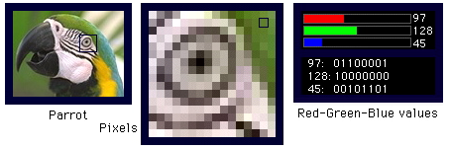
Take a 640x480 (=30,7200) pixel image.
Using only 1 LSB, can hide 115,200 characters
Using 4 LSBs, can hide 460,800 characters.

Slide 36
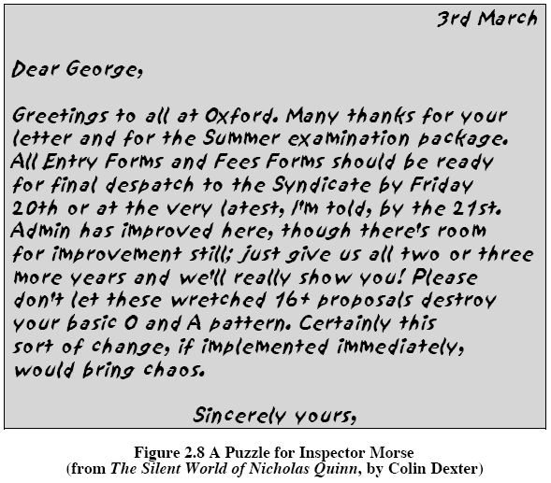

Slide 37
Summary
Have considered:
classical cipher techniques and terminology
monoalphabetic substitution ciphers
cryptanalysis using letter frequencies
Playfair cipher
polyalphabetic ciphers
transposition ciphers
product ciphers and rotor machines
stenography

